Slide 1
Design of Strong Arm Latch
Presented by
Madhukar Saini

Slide 2
Introduction
Resolves small, millivolt-level differential analog inputs into clean, full-scale rail-to-rail digital logic levels (0 to VDD​).It compares two input voltages V_{INP} and V_{INN} and produces a full-swing digital output.
Strong Arm Latch is an clocked comparator
Employs back-to-back CMOS inverters providing strong positive feedback
Requires no external bias currents (Ibias​) or continuous-time high-gain op-amp loops.

Slide 3
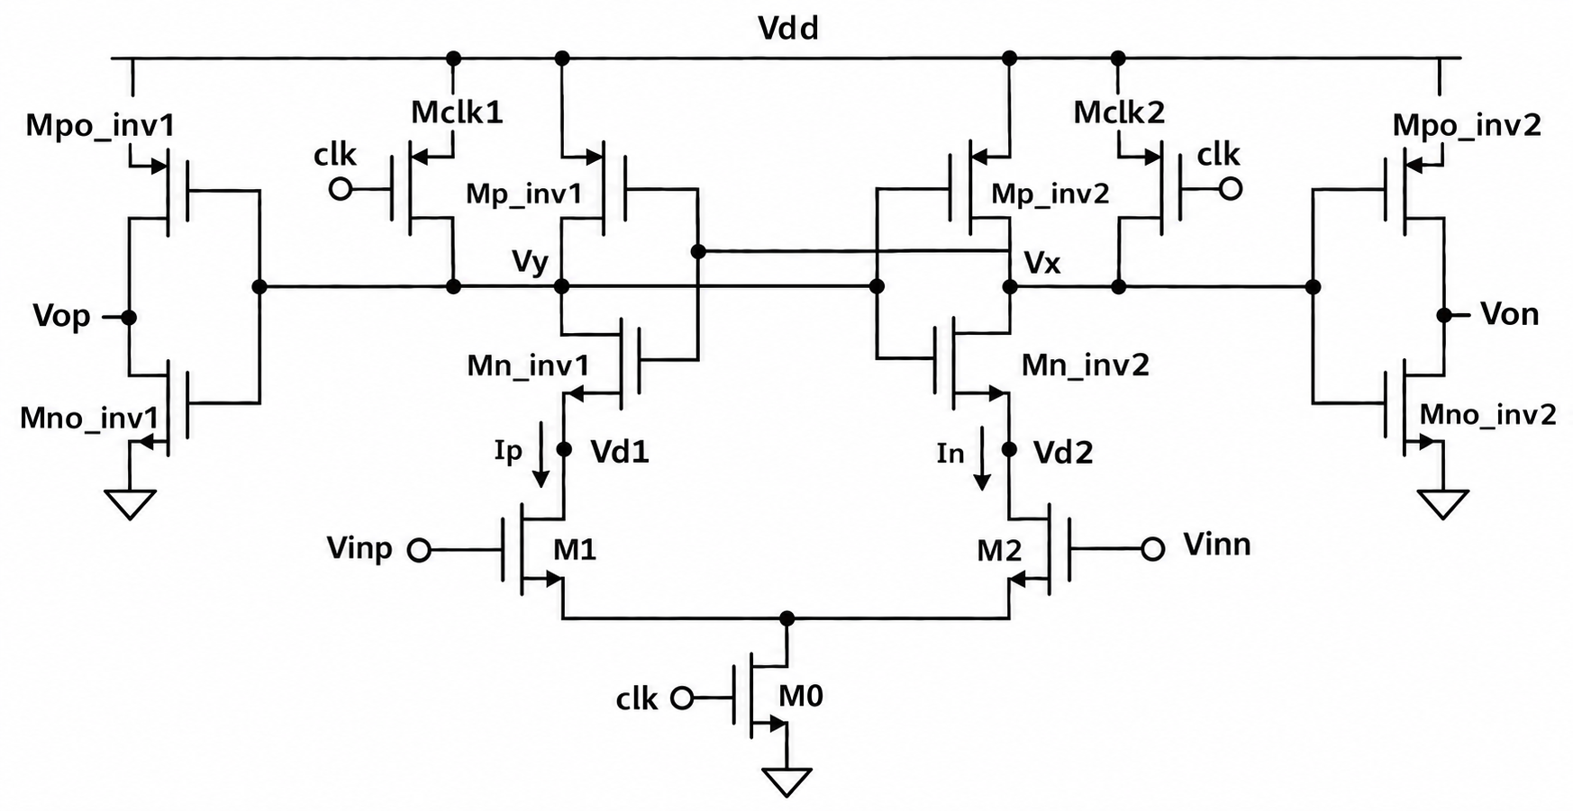
Circuit
Cross coupled Inverters
Clocks for reset
Clocked differential pair

Slide 4
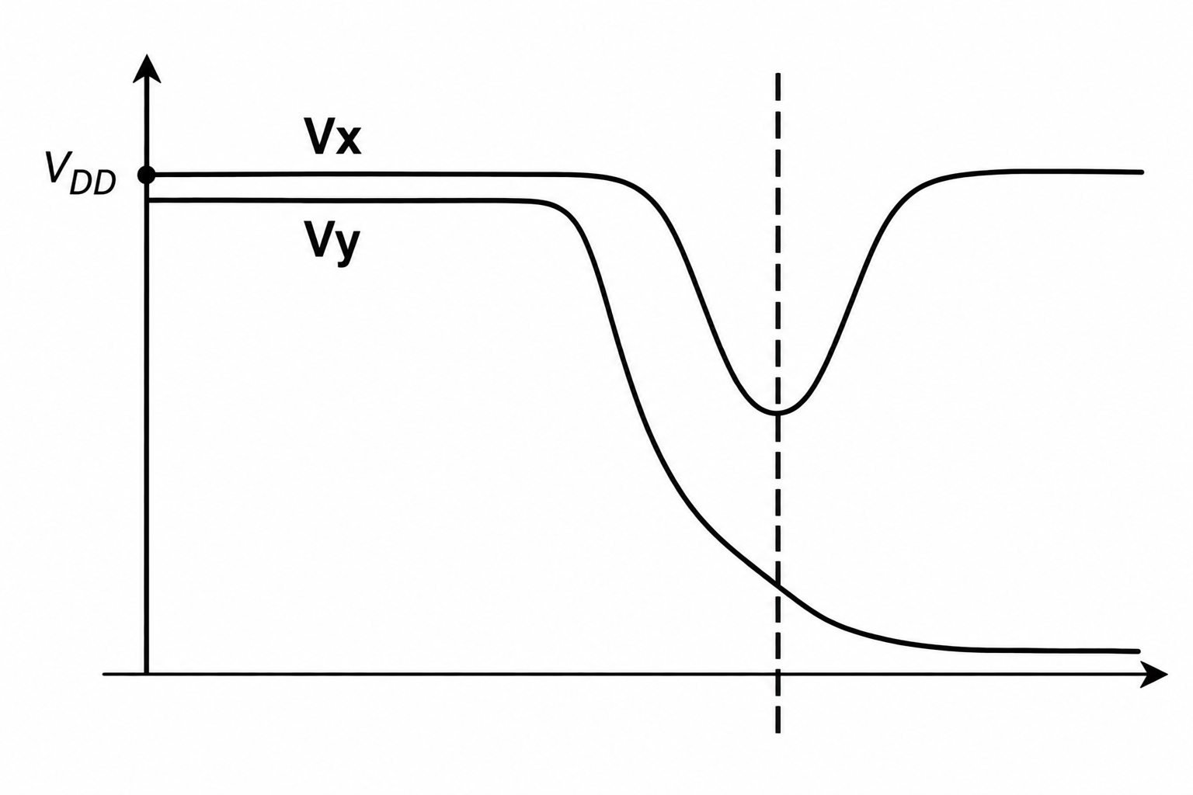
Operation
When the clock is zero the PMOS devices (MClk1 and MClk2) turns ON VX and VY are set to VDD and rest of the circuit will gets disabled. This is called as RESET phase
When the clock turns ON, the differential input pair gets enabled so Ip and In will start to flow and Vx,Vy will start discharging, Mp_inv2 and Mn_inv1 will turn on First (for Vip > Vin) → left side nodes (Vy, Vd1) discharge rapidly than the right side nodes(Vx, Vd2) pulling towards ground.
Time instance where the back to back inverters tries to make a decision
Node | (Inversion)
Vx | Von
Vy | Vop
t

Slide 5
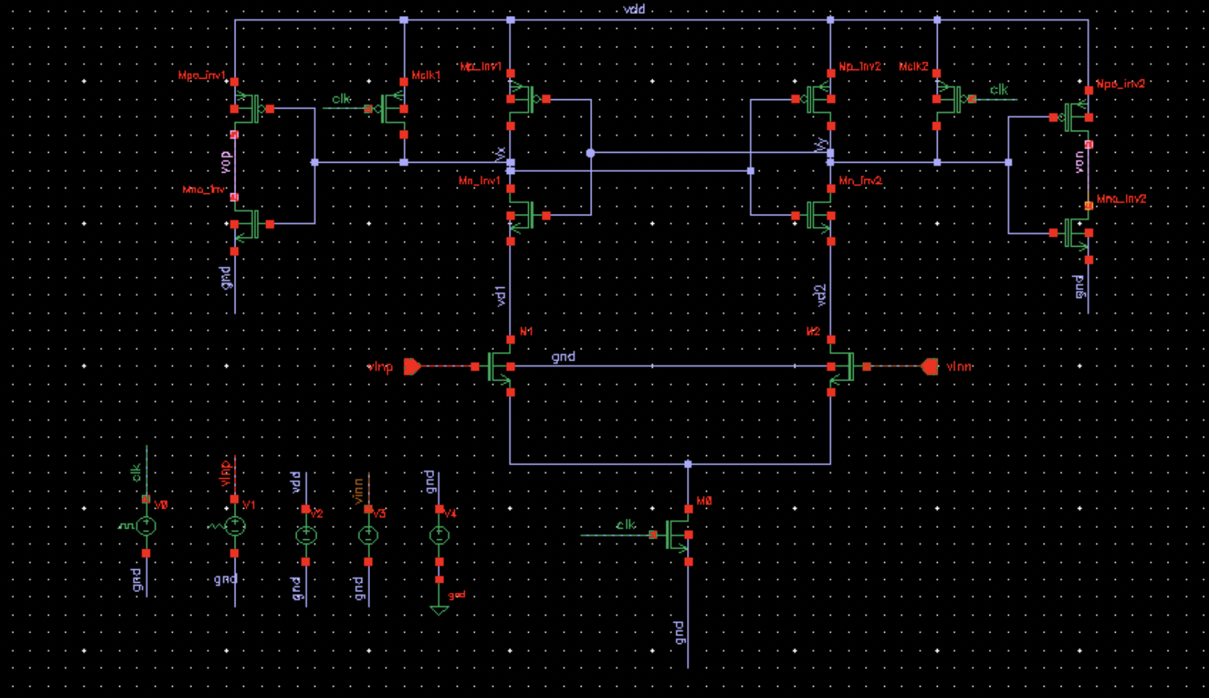
Designed Schematic

Slide 6
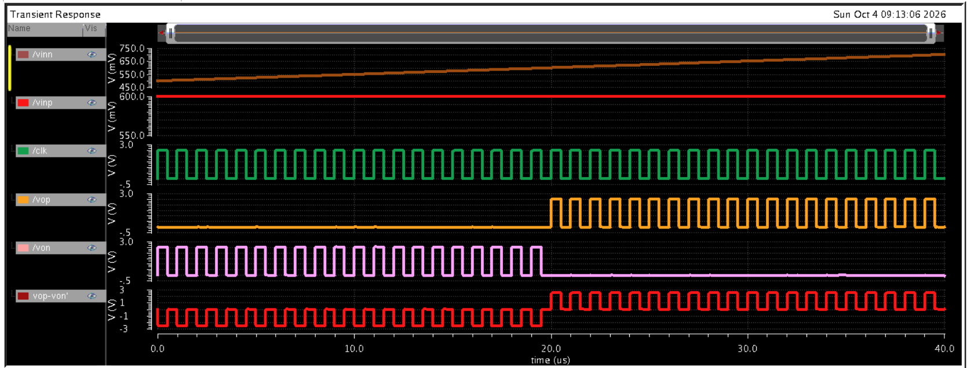
Results

